Slide 1
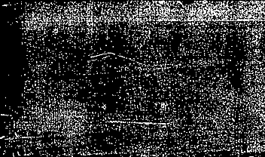

Genetic Disorders,
Vaccine Development,
CRISPR, Genomics

Slide 2
Genetic disorder
What are some common genetic disorders that you have heard of?

Slide 3
Genetic disorders

Slide 4
common Examples
Diabetes
Cystic Fibrosis
Down Syndrome
Sickle Cell

Slide 5
Insulin
Hormone made by the pancreas, Beta cells in islets of Langerhans
Helps control the level of glucose(sugar) in your blood
Insulin lowers your blood sugar level, Glucagon naturally raise it.
Discovered in 1921 by Banting and Best from dog pancreas. Focus on: Insulin – EMBL ELLS
RCSB PDB: Homepage
INS insulin [Homo sapiens (human)] - Gene - NCBI

Slide 6
Types of Diabetes
Condition | What happens? | Results
Type I | No insulin produced | High blood sugar
Type II | Insulin produced, but cells don’t respond well | High blood sugar
Hypoglycemia | Too much insulin | Blood sugar too low

Slide 7

The Dark Side of Insulin
Patent for Insulin was sold to U Toronto
for
Cost of Insulin by Country 2025
Eli Lilly, Novo Nordisk, and Sanofi top manufacturers
Insulin Costs Plummet: A Decade-Long High Comes to an End - GoodRx
$1

Slide 8
How is insulin manufactured?

Slide 9
Human insulin consists of 51 amino acids, while porcine insulin consists of 30 amino acids

Slide 10
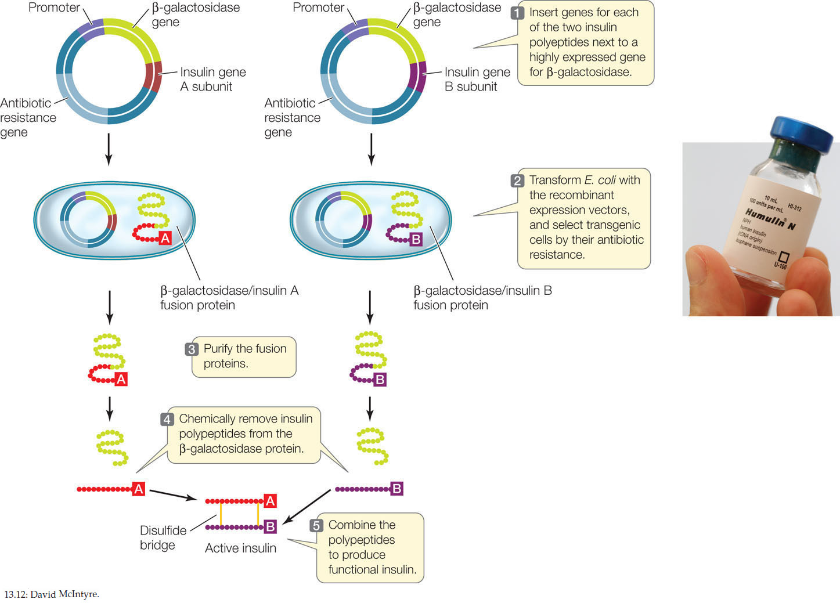

Slide 11
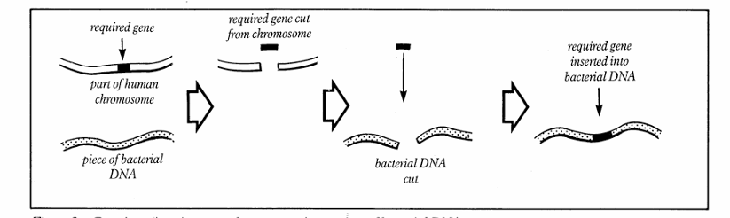

Slide 12
Genetic Engineering
Making synthetic human insulin
Why Diabetics Are Making Homemade Insulin
Using Gene-Editing to Cure Type 1 Diabetes
Genetic Modification Explained || Insulin-Producing Bacteria

Slide 13

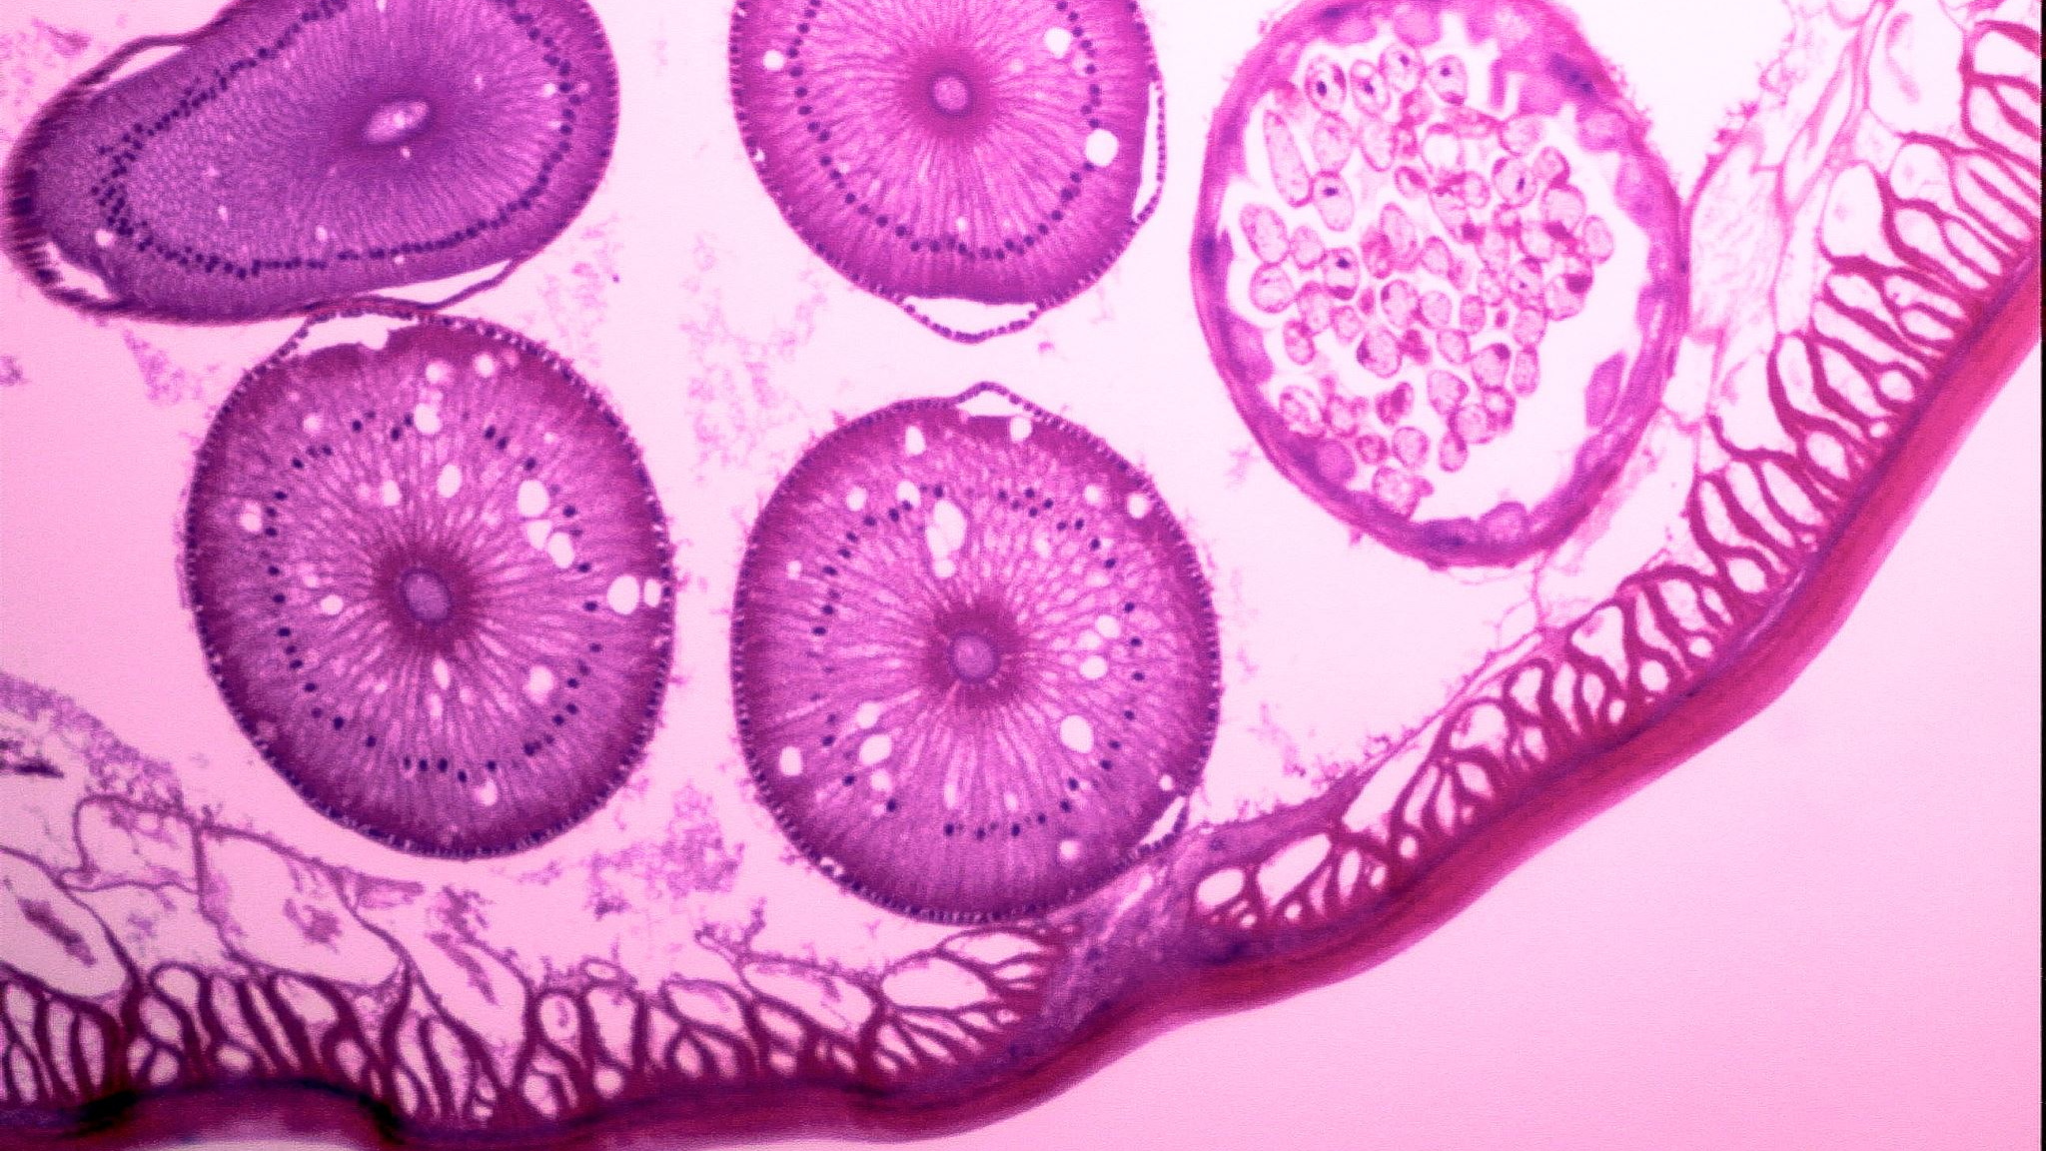
Cystic Fibrosis

Slide 14
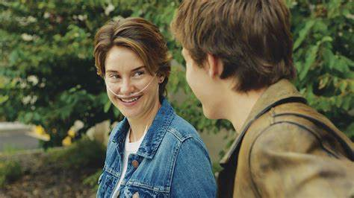


Slide 15
What is CF?
Mutation in the Cystic Fibrosis Transmembrane Conductance Regulator (CFTR) gene
Faculty CFR protein changes how much salt movies in and out cells
Causes thick and sticky mucus and increase salt in sweat
Interruprs function of vital organs, esp the lungs
Also involves the pancreas
No current cure but there have been developments cystic-fibrosis-patient-newsletter.pdf
Effects Effects of CF - Johns Hopkins Cystic Fibrosis Center

Slide 16

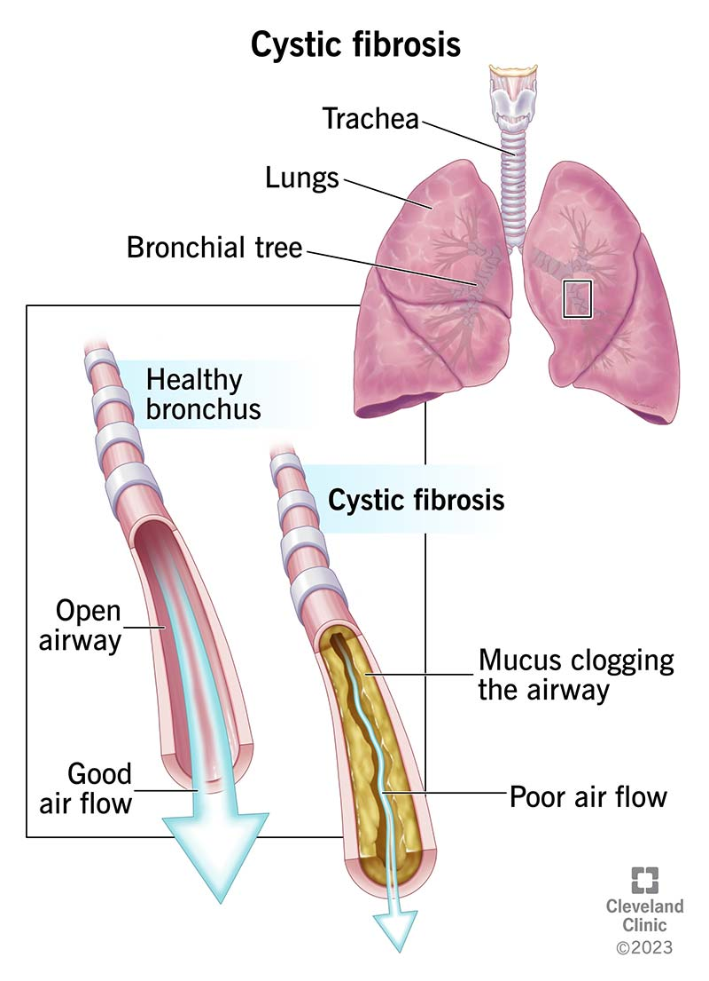


Slide 17
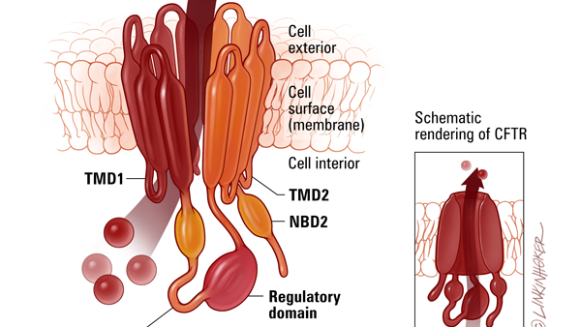

Slide 18
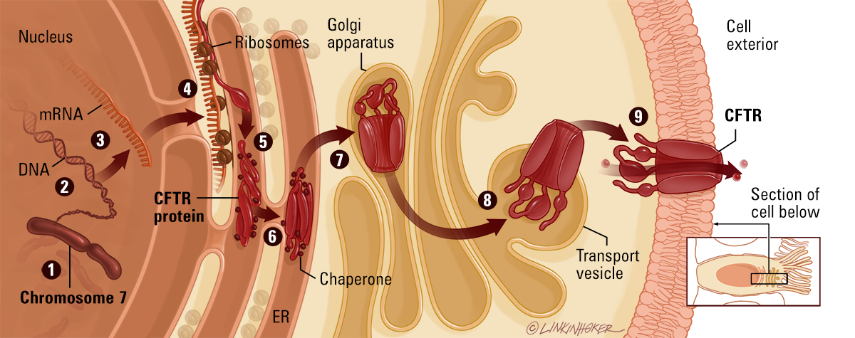
Notes:
CFTR - Johns Hopkins Cystic Fibrosis Center

Slide 19
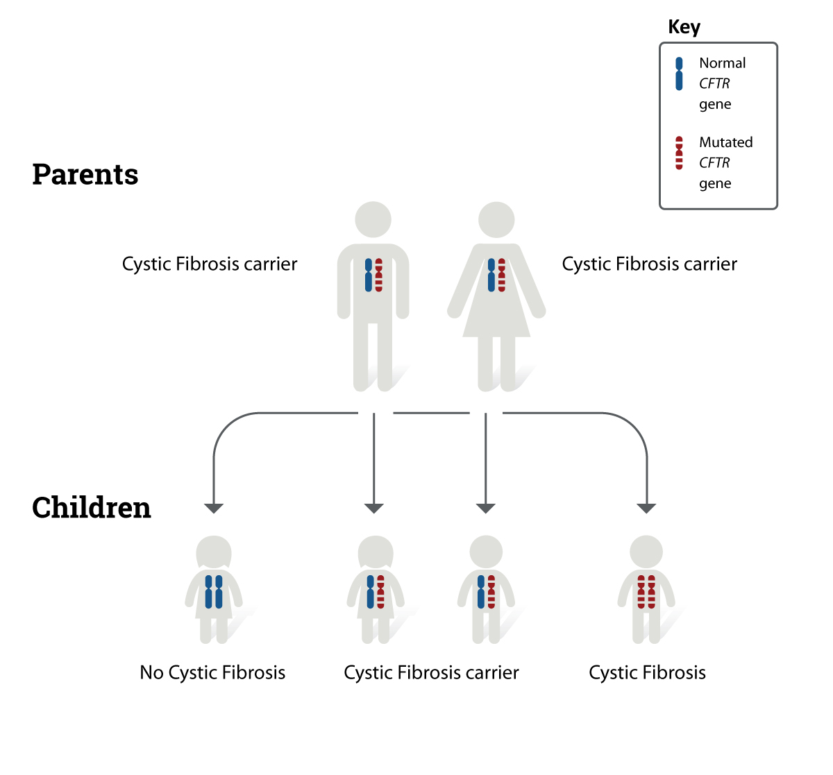

Slide 20
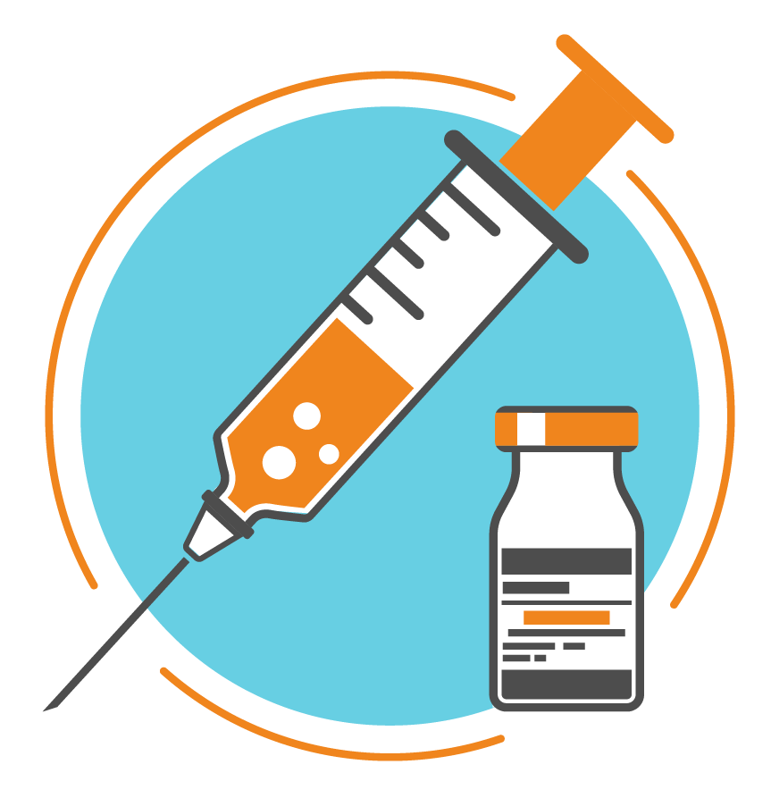
Vaccines

Slide 21
Genetic disorder
Smallpox Research | Smallpox | CDC
What are some common vaccines that you know?
Timeline of human vaccines - Wikipedia
Vaccine Schedules | Childhood Vaccines | CDC

Slide 22
Antibiotics, Antivirals, and Vaccines
Viruses (Updated)

Slide 23
Types of Vaccines
Vaccines 101 | History of Vaccines
How Are Vaccines Actually Made - YouTube
Inactivated vaccines
Live-attenuated vaccines
Subunit
Toxoid
Messenger RNA (mRNA) vaccines
Notes:
Inactivated: Hep A. Flu, Polio, Rabies
Live: MMR, Smallpox, chicken pox

Slide 24
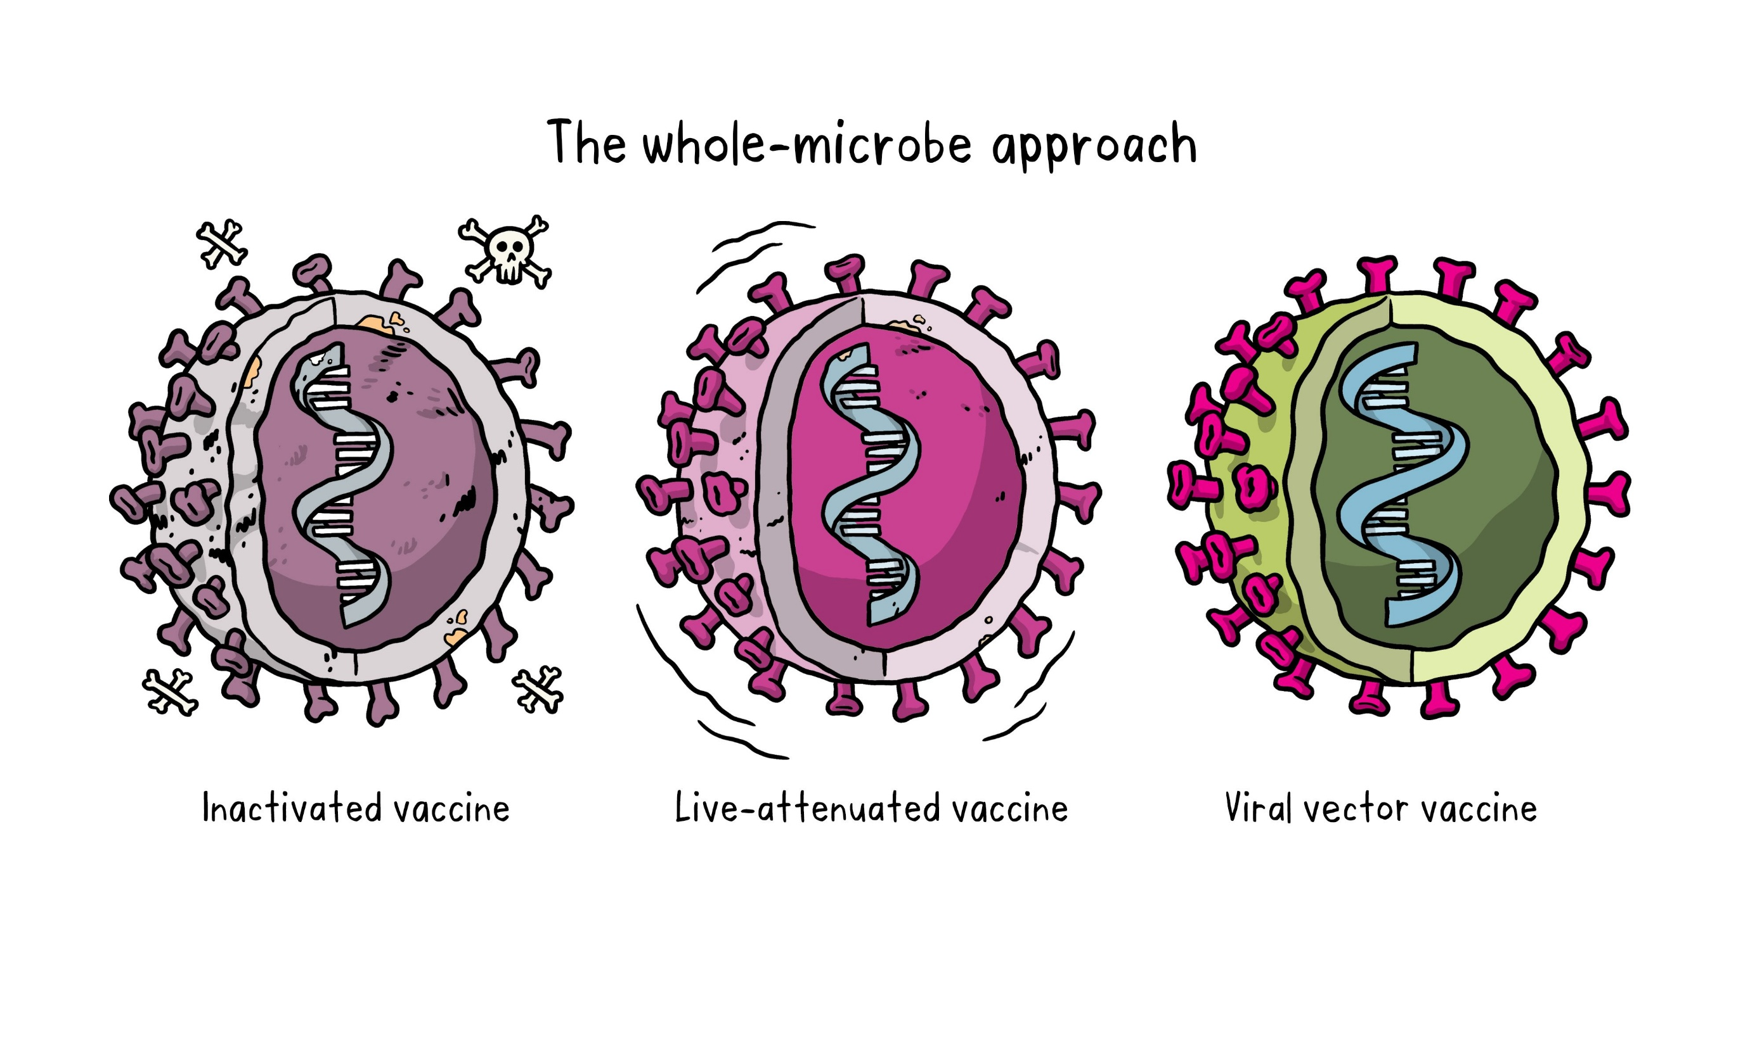

Slide 25
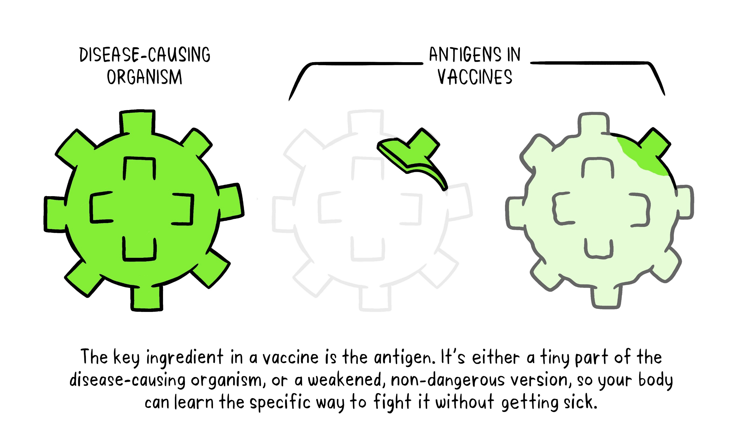

Slide 26
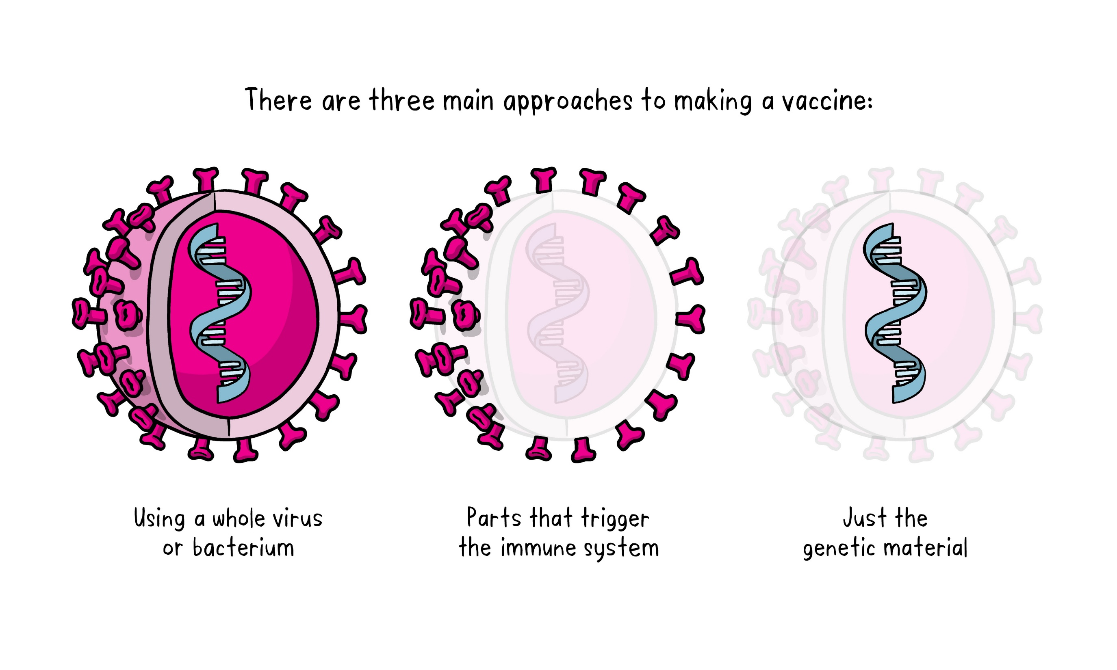

Slide 27
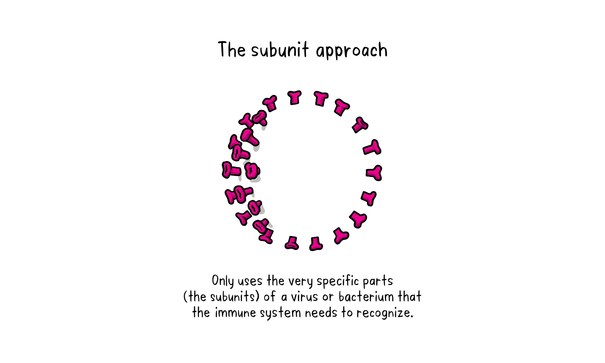

Slide 28
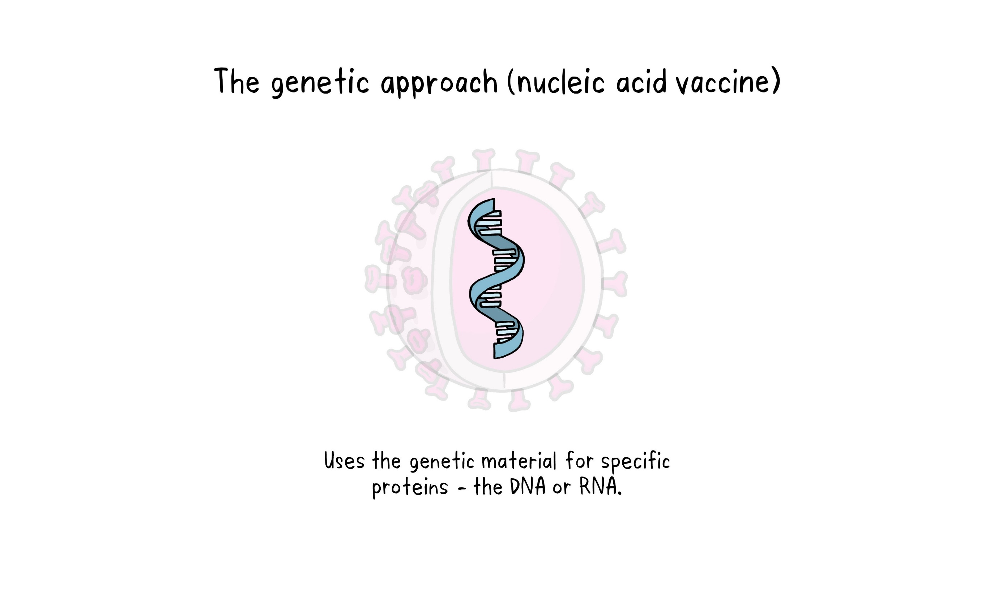

Slide 29
How long does it take to make a vaccine?
(174) How the COVID-19 vaccines were created so quickly - Kaitlyn Sadtler and Elizabeth Wayne - YouTube
How Long It Took to Develop Other Vaccines in History - Business Insider

